Slide 1
The Reign of Truth
Revelation 20

Slide 2
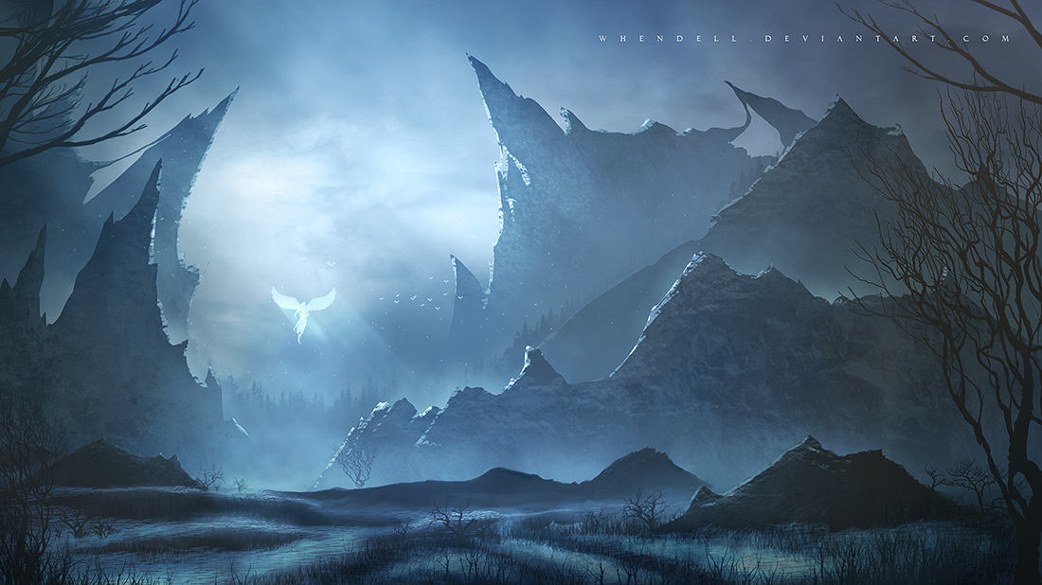
The Greatest Threat to Human Life
2 Corinthians 11:14-15 For even Satan disguises himself as an angel of light. Therefore it is not surprising if his servants also disguise themselves as servants of righteousness…

Slide 3
The Greatest Threat to Human Life
7-yr Period of “Great Trouble”
Earth nearly destroyed
The “King of Truth” Stops It
Peaceful Global Unity

Slide 4
The Greatest Threat to Human Life
Revelation 20:1-3 Then I saw an angel coming down from heaven, holding the key of the abyss and a great chain in his hand. And he laid hold of the dragon, the serpent of old, who is the devil and Satan, and bound him for a thousand years; and he threw him into the abyss, and shut it and sealed it over him, so that he would not deceive the nations any longer, until the thousand years were completed; after these things he must be released for a short time.

Slide 5
The Greatest Threat to Human Life
“War Goes Viral”
In this conflict, reality itself is up for grabs
Today, netwar is a daily reality
A disbelieving, fragile, unconscious audience is much easier to manipulate
A dark future: a world without facts…will be a more dangerous one
A perpetual state of mistrust…increases the likelihood of conflict
Notes:
The Atlantic: Nov/2016 → “How Social Media is Being Weaponized ACROSS THE WORLD”
=Global Deception @ Lightening-Fast Past

Slide 6
The Greatest Threat to Human Life
Jesus Said It:
Matthew 24:24 “False Christs and false prophets will arise and will show great signs and wonders, so as to mislead, if possible, even the elect.”
Luke 18:8 “When the Son of Man comes, will He find any faith left on the earth?”
Matthew 24:10 "At that time many will fall away and will betray one another and hate one another.
Matthew 24:12 "Because lawlessness is increased, most people's love will grow cold.

Slide 7
The Greatest Threat to Human Life
“love will grow cold”
Many…don’t start dating until after they’ve had sex
[50 yrs ago] 72% men & 87% women were married by 25. By 2012 it had reversed.
“When I found myself with total sexual freedom, I was unhappy”
Notes:
Atlantic Monthly → Nov/2016 → LOVE=COLD!!
Women=Authors → Trying 2 Navigate “New Wrld of Love”
Incl. Online Love → AP: Millennials → DON’T B DECEIVED

Slide 8
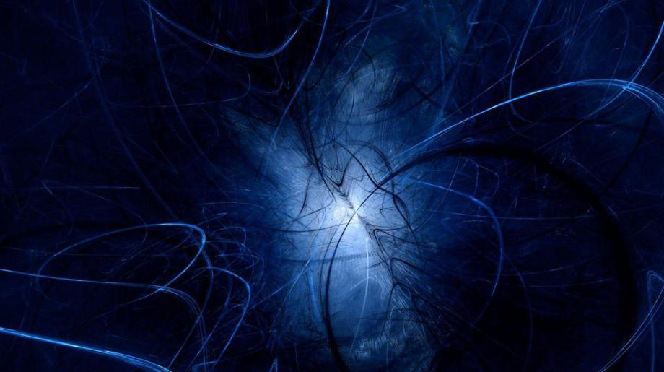
The End of an Era
he laid hold of the dragon, the serpent of old, who is the devil and Satan, and bound him for a thousand years; and he threw him into the abyss
Notes:
"Serpent..Old"= Eden→Awakens & Appeala to R Lust/Appetites
ALL R Death, Disease, Injustice, Darkness, Inhumanity =Organic/Intelligent
Dragon = mysterious, invisible, hostile power
Devil = Slanderer, makes God =unloving, evil
Satan = Adversary of Anyth. God Wnts→ Esp. God's love
“Bottomless" = Hrd. 2 Underst→ "limitless reaches of depravity"

Slide 9
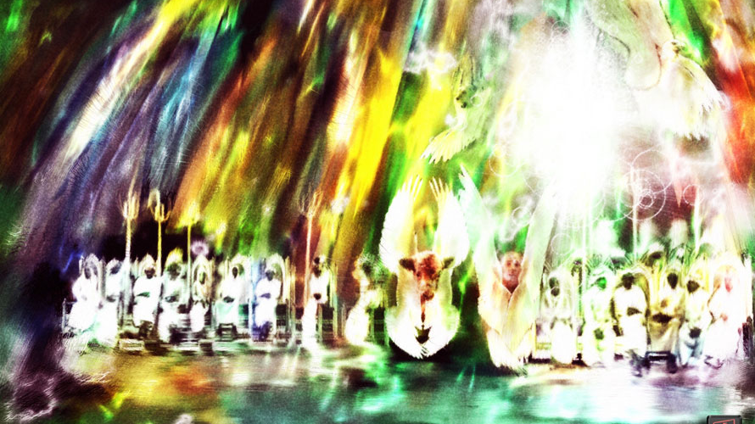
A Judgement of Truth
Revelation 20:4-6 Then I saw thrones, and they sat on them, and judgment was given to them.
Notes:
CLEANUP=Req. **Judgement 1st = OFFENDS Ppl!!
= #1 Deceit: “G’s Judgement=Bad!!” Truth=w/o Judge=BAD
YET: We KNOW We’re Accountable & SHOULD BE
IL: “Dear Zachary” → Calls 4 ACCOUNTABILITY

Slide 10
A Judgement of Truth
By The Saints
Over the Earth
Across the Universe
Over Angelic Beings
Matthew 25:32-34 “All the nations will be gathered before Him; and He will separate them from one another, as the shepherd separates the sheep from the goats; and He will put the sheep on His right, and the goats on the left. Then the King will say to those on His right, 'Come, you who are blessed of My Father, inherit the kingdom prepared for you from the foundation of the world…’”
Ephesians 1:19-22 This is the surpassing greatness of His power toward us who believe. ... He raised Him from the dead and seated Him at His right hand in the heavenly places, far above all rule and authority and power and dominion, and every name that is named, not only in this age but also in the one to come. And He put all things in subjection under His feet, and gave Him as head over all things to the church,
1 Corinthians 6:3 Do you not know that we will judge angels?
1 Corinthians 6:2 Do you not know that we will judge the world?
Notes:
w/Christ→ **His CHURCH =Eph.1:19-22=The Heavenly Realm,
**Est. Order Thru the Whole Universe
out into the vast reaches of space itself...
**Angelic Beings 1 Cor. 6:3 **& Earth 1Co.6:2
**Mt.25 =Sheep/Goat Judgement

Slide 11
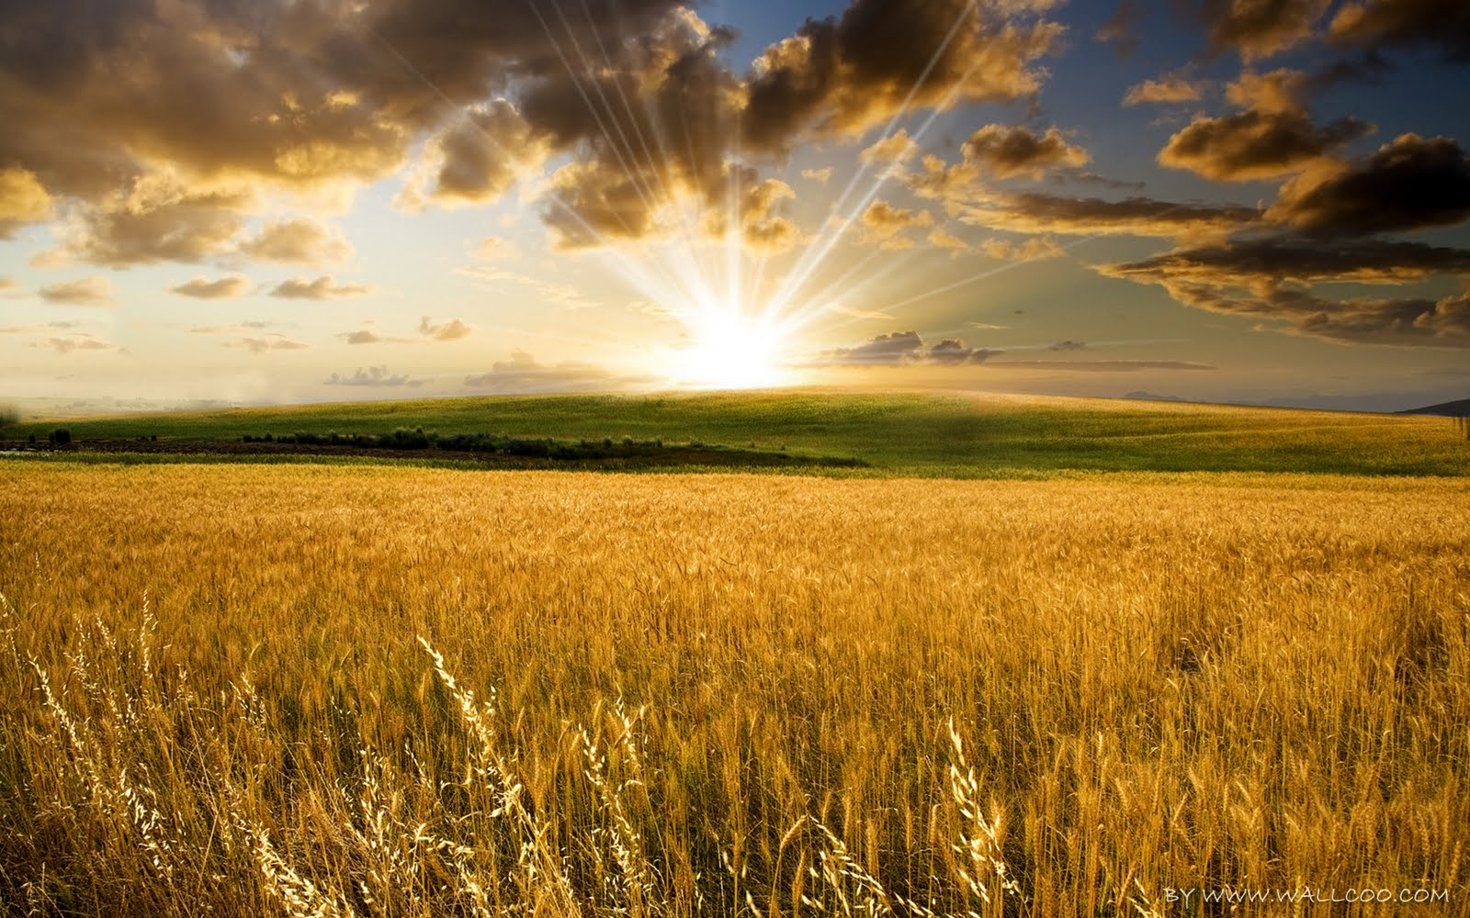
The Millennial Kingdom
And I saw the souls of those who had been beheaded because of their testimony of Jesus and because of the word of God, and those who had not worshiped the beast or his image, and had not received the mark on their forehead and on their hand; and they came to life and reigned with Christ for a thousand years.
Isaiah 35:1 The wilderness and the desert will be glad, And the Arabah will rejoice and blossom;
Isaiah 35:7 The scorched land will become a pool And the thirsty ground springs of water;
Isaiah 35:5-6 Then the eyes of the blind will be opened And the ears of the deaf will be unstopped. Then the lame will leap like a deer, And the tongue of the mute will shout for joy…
Isaiah 65:20 "No longer will there be in it an infant who lives but a few days, Or an old man who does not live out his days; For the youth will die at the age of one hundred And the one who does not reach the age of one hundred Will be thought accursed.
Isaiah 35:10 …They will find gladness and joy, And sorrow and sighing will flee away.
Trib Saints Raised
Ruling Over Mortals
Ecology Changes
Medical Changes
Love Works!
Notes:
M.K. Begins w/ **Saints Raised
RULE Earth=**Mortal Believers Left Aftr Judgmnt
** Ecolog.Changes =NUKE Cleanup/Sea Life
** Med. Changes ** Longevity **Relat.Chng Is.35

Slide 12
The End of “The Lie”
Kids Play With Vipers
Lion & Lamb Play Together
Talking Animals?
“Folding” Space?
John 8:44 "You are of your father the devil, and you want to do the desires of your father. He was a murderer from the beginning, and does not stand in the truth because there is no truth in him. Whenever he speaks THE Lie, he speaks from his own nature, for he is a liar and the father of lies.
Romans 8:21-22 the creation itself also will be set free from its slavery to corruption into the freedom of the glory of the children of God. For we know that the whole creation groans and suffers the pains of childbirth together until now.
Notes:
“THE LIE” = “U Can B LIKE GOD!” = All R Probs On Earth
** Rom. 8:21f = Corruption All Around w/o G
** Kids/Vipers ** Lion/Lamb ** Talk.Anim? ** Space Travel?
=End of “Survival of Fittest” = Satan’s Kingdom

Slide 13
The Beginnings of Eternal Life
1st Resurrection
Began with JC
The Rapture
Post-Trib
Revelation 20:4-6 …they came to life and reigned with Christ for a thousand years. The rest of the dead did not come to life until the thousand years were completed. This is the first resurrection. Blessed and holy is the one who has a part in the first resurrection; over these the second death has no power, but they will be priests of God and of Christ and will reign with Him for a thousand years.
John 5:24 "Truly, truly, I say to you, he who hears My word, and believes Him who sent Me, has eternal life, and does not come into judgment, but has passed out of death into life.
Notes:
** 1st Ress=STAGES → **JC=1st Fruits=PROOF!!
** Rapture=Church/OT ** Post-Trib Saints
** Jn.5=PROMISE → “Whew!!”

Slide 14
The Beginnings of Eternal Life
John 5:22 "For not even the Father judges anyone, but He has given all judgment to the Son
Revelation 20:4-6 …they came to life and reigned with Christ for a thousand years. The rest of the dead did not come to life until the thousand years were completed. This is the first resurrection. Blessed and holy is the one who has a part in the first resurrection; over these the second death has no power, but they will be priests of God and of Christ and will reign with Him for a thousand years.
John 12:47 “…I did not come to judge the world, but to save the world.”
Acts 4:12 "And there is salvation in no one else; for there is no other name under heaven that has been given among men by which we must be saved."
Notes:
“Rest…Dead” = JUDGEMENT → G.W.T. & Heaven = Nxt
** Jn.5 JC=Judge of ALL LIVING Souls → ** Jn.12 ~Wanna Judge!
** Acts 4→ JC Saves!! → ??Else Save U?? → ??Else KNOWS??
GOSP: Coming 4 Answers? → HERE IT IS! → RECEIVE FORGIVNESS!
^ Ur “Relig” = LIES?? →Wrld of Deceit

Slide 15
Build a Future!
1 Corinthians 13:13 Three things will last forever—faith, hope, and love—and the greatest of these is love.
Knowing & Trusting God’s Word
Living in Hope, Not Fatalism
Love Those in Need
SIGNIFICANCE
Notes:
Build Future=U R Gonna RULE w/ JC
** 1Co.13=INVEST!! =the TRUTH!! LIES=All Around U
** TRUST in G & WOG → “Hvn/Earth Pass Away…”
** =Results in HOPE=New “Fate” → ~Fatalism (^Short-Circuit It!)
** Luv=New Vision 4 Ppl→HOPE-Based=RESOLVE / Caring=WORKS!
Let Ppl IN! → G. Needs **SIGNIF. Ppl = Parable of 10/5 Cities
Love=Lrn G’s Wisdom→ “GREATEST” →SACRIFICE=Best INVEST.

